Slide 1
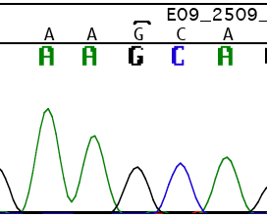
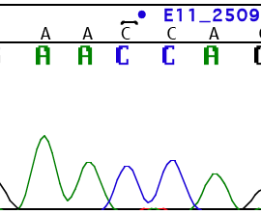
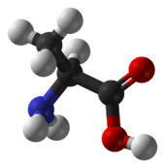
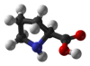
G to C mutation in Eif4g3 was identified
Wild Type
repro8 carries an ENU-induced mutation.
repro8 has small testes.
Only males are infertile: arrest at meiotic prophase I with normal sexual behavior, components of major cell cycle regulator present. HSPA2 is dramatically reduced in the mutant.
The mutation was identified in Eif4g3 (eukaryotic translation initiation factor 4 gamma, 3 ).
A testis specific variant was identified.
The mutation is a missense mutation: alanine to proline.
repro8/repro8
Alanine
Proline

Slide 2
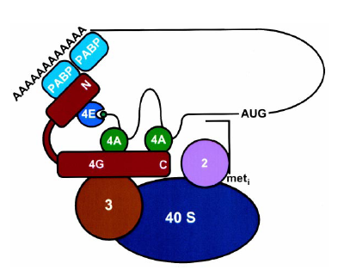
EIF4G serves as a scaffold protein in pre-initiation complex
Protein of EIF4G3
aa.
1
250
500
750
1000
1250
1500
1578
MIF4G
MA3
W2
PABPC1
EIF4E
EIF3/EIF4A
EIF4A
5 HEAT repeats
Coiled coil
MNK
Notes:
Translation initiation is a sophisticated, well regulated and highly coordinated cellular process in eukaryotes, in which at least 11 eukayrotic initiation factors (eIFs) are included. The W2 domain (two invariant tryptophans) is a region of ~165 amino acids which is found in the C terminus of the following eIFs [PMID: 8520487, PMID: 10958635, PMID: 14681227, PMID: 16616930, PMID: 16781736]:
Eukaryotic translation initiation factor 2B epsilon (eIF-2B-epsilon).
Eukaryotic translation initiation factor 4 gamma (eIF-4-gamma).
Eukaryotic translation initiation factor 5 (eIF-5), a GTPase-activating protein (GAP) specific for eIF2.
The W2 domain has a globular fold and is exclusively composed out of alpha- helices [PMID: 14681227, PMID: 16616930, PMID: 16781736]. The structure can be divided into a structural C-terminal core onto which the two N-terminal helices are attached. The core contains two aromatic/acidic residue-rich regions (AA boxes), which are important for mediating protein-protein interactions.
This domain is found at the C-terminus of several translation initiation factors, including the epsilon chain of eIF2b, where it has been found to catalyze the conversion of eIF2.GDP to its active eIF2.GTP form. The structure of the domain resembles that of a set of concatenated HEAT repeats.

Slide 3
Dynamics of global protein synthesis in vitro is similar in repro8 mutants and heterozygote littermate controls
Cell viability > 90%
1/23/2012

Slide 4
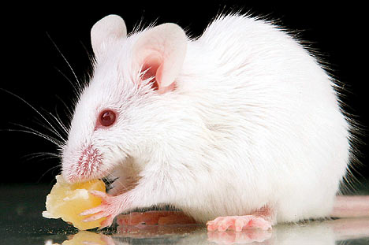
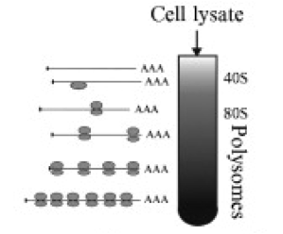
Sucrose gradient-velocity polysome sedimentation
homogenize testes
RNA extraction
Analysis
Notes:
Translation of an mRNA molecule occurs in a multimeric structure, the polysome, which consists of multiple ribosomes arrayed along the length of the mRNA. Polysomes are readily separated according to the number of associated ribosomes by velocity sedimentation through a gradient of sucrose, which serves to stabilize the boundaries of the sedimenting zone.

Slide 5
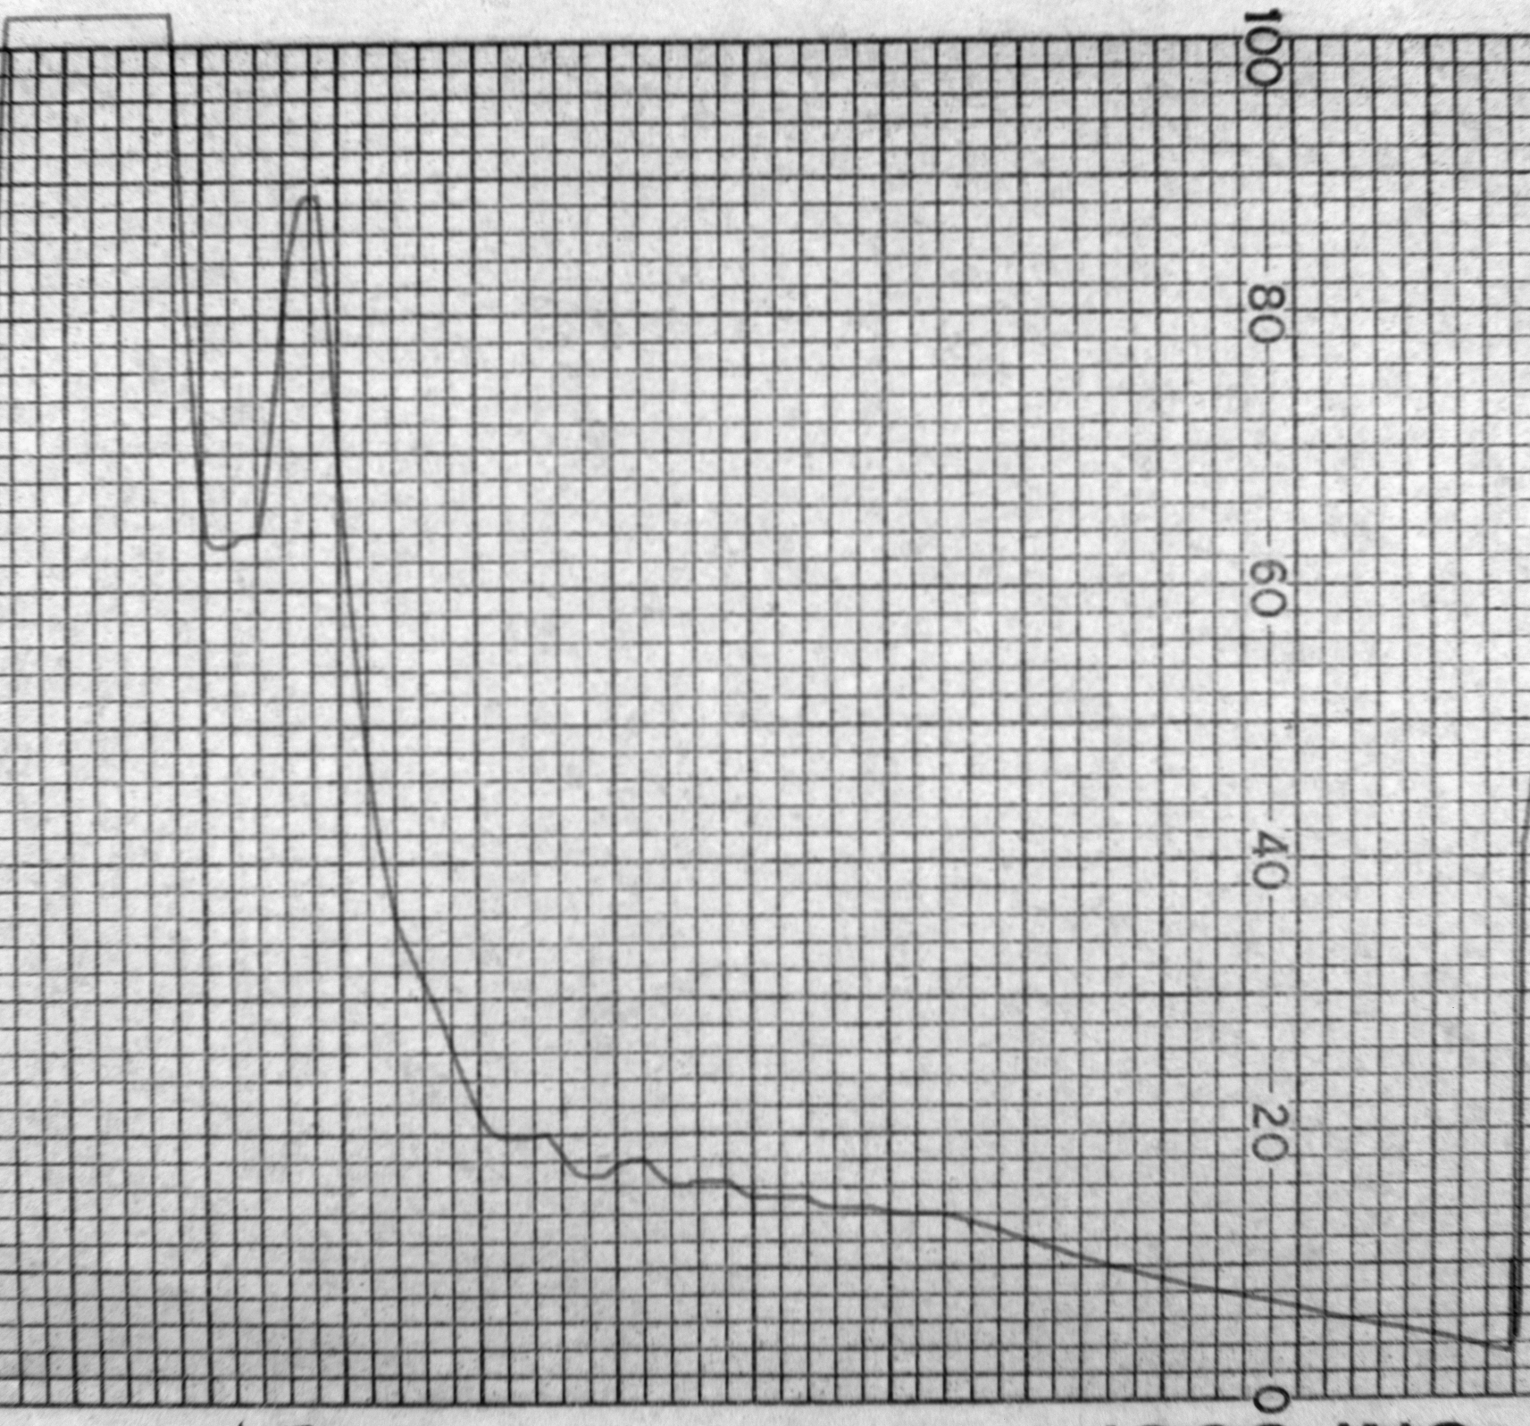
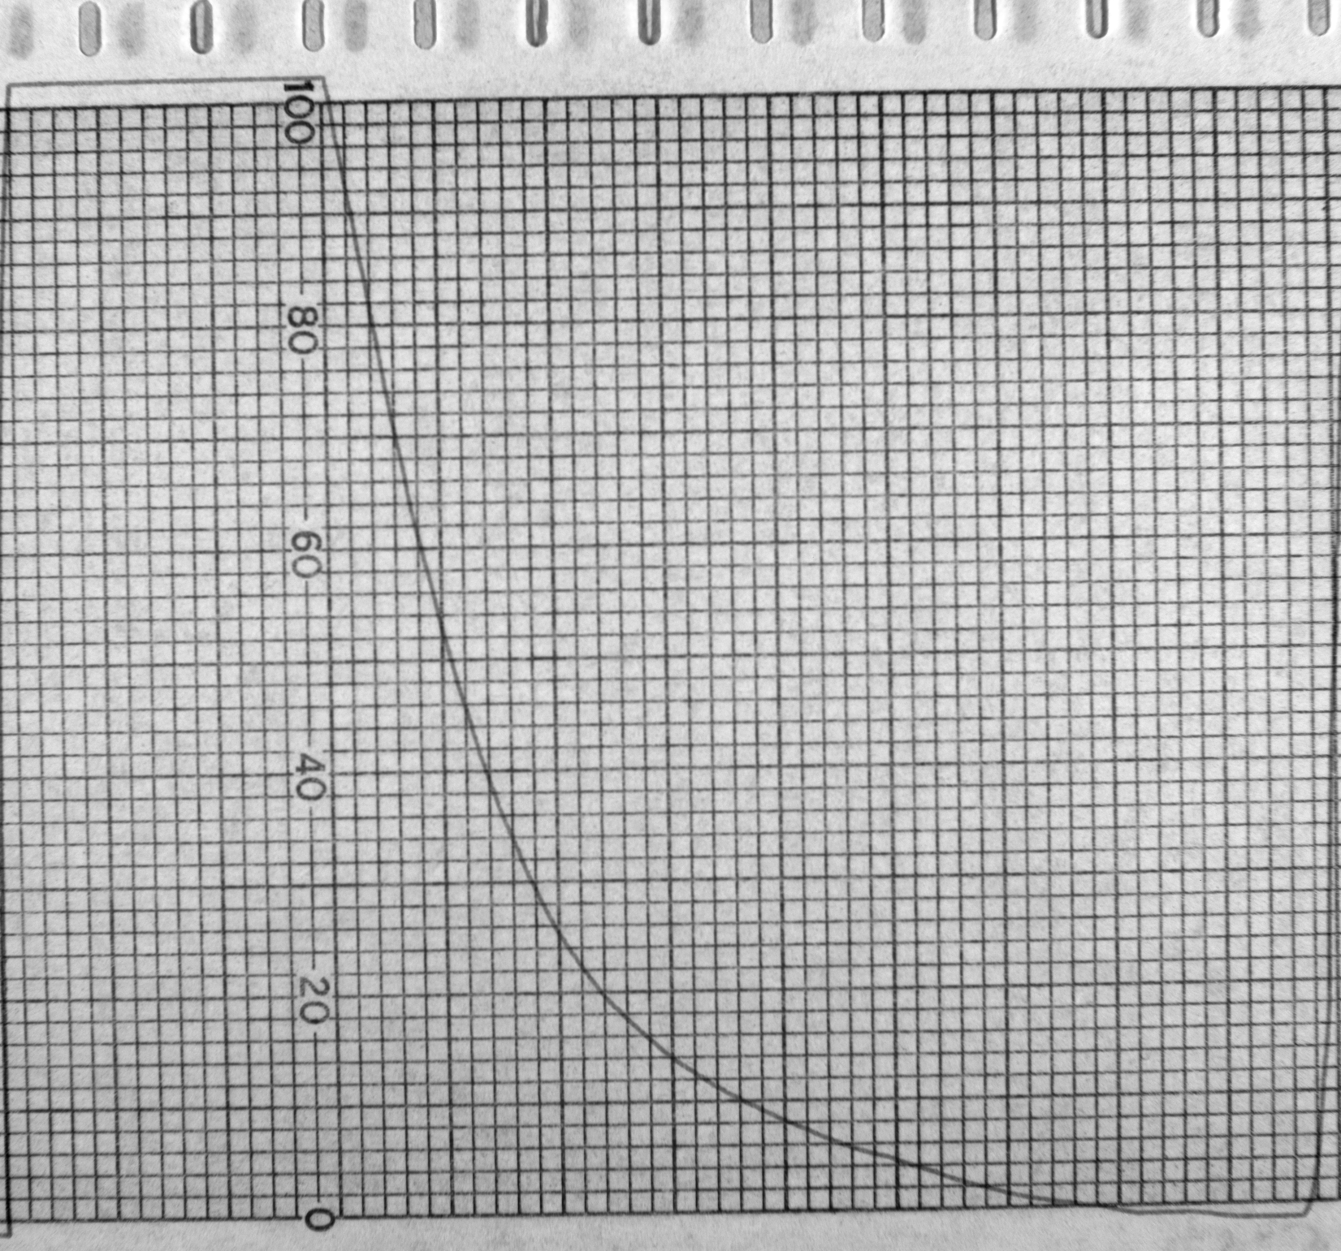
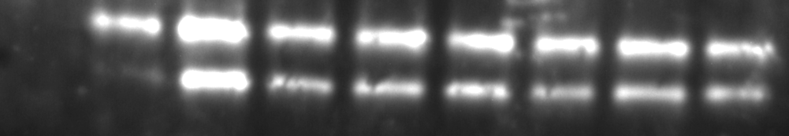
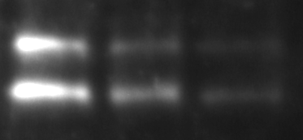
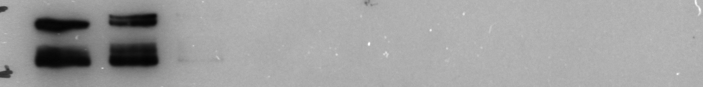
Characterization of polysome profile
EDTA
Fractions
1 2 3 4 5 6 7 8 9 10 11 12
1 2 3 4 5 6 7 8 9 10 11 12
S6
EIF4G3
RPL10
Non-polysome
polysome

Slide 6
No significant change of transcription in repro8 mutant testes
Notes:
Not reported at lab meeting

Slide 7
Hspa2 transcript shifts from heavy to light polysome in Repro8 MT testes
Notes:
Not reported at lab meeting

